Slide 1
Documentum Users & Privileges And Group/Role
Notes:
Place the audio notes for this slide here

Slide 2

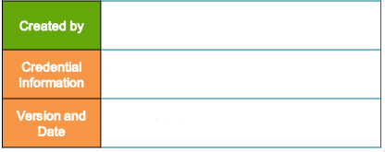
Sridher Siripuram(622216)
Documentum Users & Privileges And Group/Role
V 1.1, 23rd March 2018

Slide 3
Agenda
Documentum Users & it’s Privileges
Groups/Roles

Slide 4
Documentum Users & it’s Privileges

Slide 5
Documentum Users & it’s Privileges
This chapter provides information on :
User Overview
Users Authentication
Authorization
User Access Settings
Client Capability
Basic Privileges
Extended Privileges
Requirement for creating a user
Creating a user
Useful Queries
Test Your Understanding
Exercise

Slide 6
User Overview
A repository user is an actual person or a virtual user who is given access to repository.
A virtual user is a repository user who does not exist as an actual person.
Key Features:
One who gains access to the Repository.
A user is represented as an object of type dm_user within the repository.
Repository users have two states, active and inactive.
An active user can connect to the repository and work.
An inactive user is not allowed to connect to the repository.
User B
Content Server
User A

Slide 7
Users Authentication
Process by which a User (dm_user) is authenticated for Logging into an Application.
Types of Authentication:
OS (Operating System)
LDAP (Lightweight Directory Access Protocol)
Inline Password (Using dm_user.user_password)
Authentication Plug-in (Netegrity SiteMinder and RSA Access Manager)

Slide 8
Authorization
Authorization pertains to controlling access to functionality.
User-specific authorization can be enforced by the client applications as well as the Content Server.
Client applications utilize a user’s client capability to enforce access control for functionality within the client application.
On the other hand, Content Server utilizes basic and extended privileges to enforce access control.

Slide 9
User Access Settings
When a user is created, the administrator determine the user’s level of access by setting the following properties.
Client Access:
Each user’s Client Capability settings determines the functionality available in a
client application.
- Enforced by specific client application.
Repository Access:
Each user’s Privileges and Extended Privileges settings determines what functionality
is available in repository.
- Enforced by Content Server.

Slide 10
Client Capability
Client applications utilize client capability for enforcing additional access control.
These client capabilities are hierarchical in the sense that one level can also imply another level.
The dm_user.client_capability attribute stores the client capability level for users.
There are four levels of client capability:
Consumer (default)
Contributor
Coordinator
System Administrator

Slide 11
Client Capability(contd.)
Consumer :
Searches a repository for documents
View documents
Copies documents
Forwards tasks from workflows
System Administrator :
Does everything the consumer can
Create new documents and folders
Edit documents
Delete documents
Checks documents in and out
Initiate workflows
Modify Virtual documents

Slide 12
Client Capability(contd.)
Coordinator :
Does everything a contributor can
Creates a new cabinet
Create virtual documents
Contributor :
Does everything the Coordinator can
Configure users and groups
Configure the content server
Maintain the repository.

Slide 13
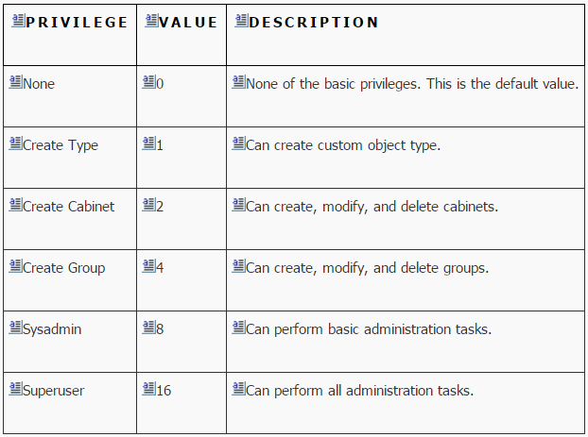
Basic Privileges
While client capabilities are enforced by a client application, privileges are enforced by the Content Server. A user’s basic privileges are set in the dm_user. user_privileges property.

Slide 14
Basic Privileges(contd.)
Privileges are not hierarchical and each privilege needs to be specified explicitly. Multiple basic privilege values can be combined by adding the corresponding integer values. Thus, if we want to grant Create Type and Create Cabinet privileges to a user, the user_privileges property needs to be set to 3 (=1+2)
While the first four privilege values are straight forward, Sysadmin and Superuser privileges need some elaboration….

Slide 15
Basic Privileges(contd.)
A user with Sysadmin privilege has following abilities:
All lower privileges as well (Create Type, Create Cabinet, Create Group)
Manipulate users and groups
Grant and revoke the lower privileges to other users
Create or modify system-level permission sets
Administer full-text indexing and repository
Manage lifecycles
Manipulate workflows

Slide 16
Basic Privileges(contd.)
A user with Superuser privilege has the following features:
Sysadmin privileges as well
Owner of all objects in the repository
Unlock checked out objects
Manipulate others’ custom types
Create null types (types with no supertypes)
Manipulate others’ permission sets
Query any underlying RDBMS tables, even if they are not registered
View all audit trail entries even if it doesn’t have explicit View Audit extended privilege
Register and unregister others’ tables

Slide 17
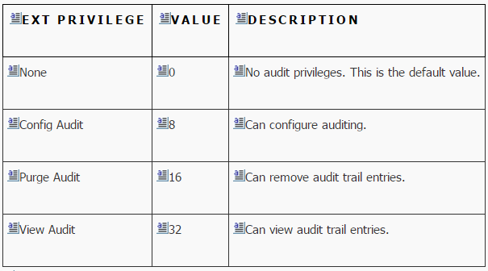
Extended Privileges
Each user also gets extended privileges, which pertain to audit trails.
The extended privileges are set in the dm_user.user_xprivileges property.

Slide 18
Extended Privileges(contd.)
The repository owner, superusers, and users with the View Audit extended privilege can view all audit trail entries.
Extended privileges are also combined by adding the corresponding integer values. For example, granting View Audit and Purge Audit results in the value 48 (=16+32).

Slide 19
Requirement for creating a user
To create a user you must have:
SYSADMIN OR SUPERUSER privilege
System Administrator client capability
Depending on the authentication configuration, users may need to be
added to Content Server operating system, domain server
or to an LDAP directory server.
A user is an object in the repository represented by dm_user object.
Can be created in several ways:
Documentum Administrator or Webtop
Programmatically
DQL or API

Slide 20
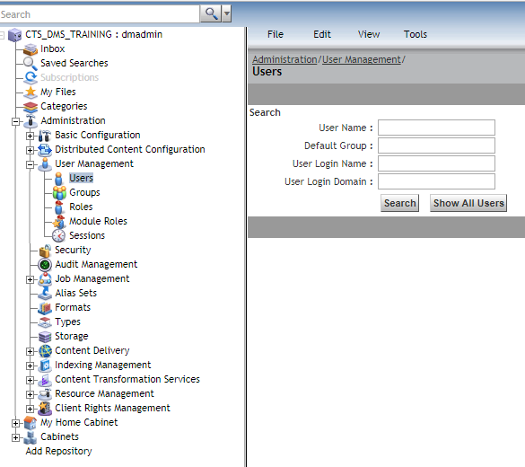
Creating a user
To create a user in Documentum Administrator or Webtop
Navigate to Administration > User Management > Users node
Select File > New > User from the menu

Slide 21
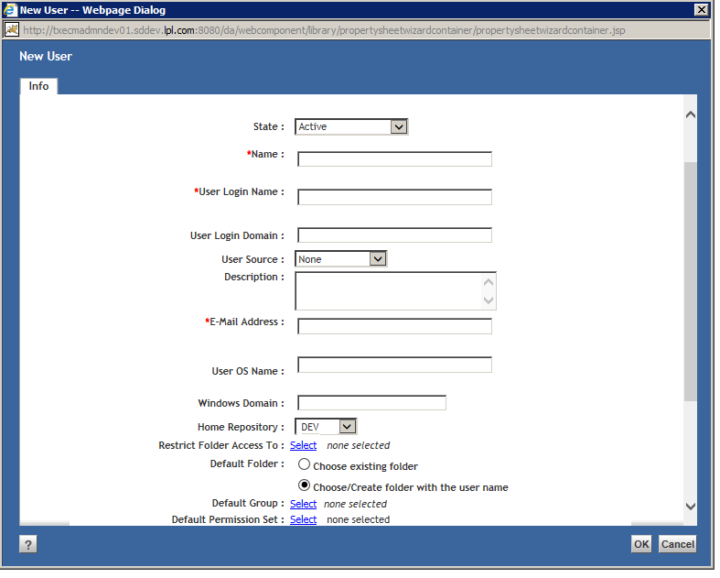
Creating a user(contd.)
The User Info screen appears
Enter values for the user properties
Click Ok to create the User.

Slide 22
Useful Queries: Users
Show when the user’s properties were last changed:
select r_modify_date from dm_user
where user_name =‘Michael’
List all deactivated user accounts in repository:
select user_name from dm_user
where user_state =1
List documents currently checked out by a particular user:
select object_name from dm_document where
r_lock_owner = ‘Sandra’

Slide 23
Test Your Understanding
True/False: All users are represented by dm_user object in repository?
True
False
Ans: a

Slide 24
Test Your Understanding
True/False: The content server enforces the client capability settings?
True
False
Ans: b

Slide 25
Test Your Understanding
Which of these is the Content server’s default user authentication method?
In-line password authentication
LDAP directory Authentication
Operating System account authentication
Plug-in authentication
Ans: c

Slide 26
Exercise
Use Documentum Administrator to:
Create user objects
Test the new user objects
Issue DQL queries

Slide 27
Documentum Groups/Roles

Slide 28
Documentum Groups/Roles
This chapter provides information on :
What is Group
Why Group?
Dynamic Group
Requirements for creating a Group
Creating a Group
What is a Role
Role Example
Roles can form a hierarchy
Creating a Role
Kinds of Group
Useful Queries: Groups and Roles
Test Your Understanding
Exercise

Slide 29
What is Group
A group is a set of members/users
A convenient way to reference a common set of users
A member can be a User or another group
Provides a subset of Users access to Objects
An instance of object type ‘dm_group’

Slide 30
Why Group?
It is very common that multiple users play the same business role in an organization and need similar levels of access. If access is granted to each user separately, it may become difficult to manage the access control due to the following reasons
There are a large number of users needing access and/or resources to be secured.
All the users with similar access levels need to be assigned new permissions.

Slide 31
Dynamic Group
A group can be a dynamic group if the members of the group can be changed when the group is being used at run time. The membership changes cannot be arbitrary.
During run time, a client can programmatically add and remove members from a dynamic group .
A dynamic group cannot be a member of a non-dynamic group but a dynamic group can have non-dynamic groups as members.
The members of the non-dynamic group are considered as potential members of the dynamic group just like the users that are direct members of the dynamic group.

Slide 32
Requirements for creating a Group
To create a group you must have:
Create Group privilege
System Administrator client capability
A group is an object in the repository.
Can be created in several ways:
Documentum Administrator or Webtop
Programmatically
DQL or API

Slide 33
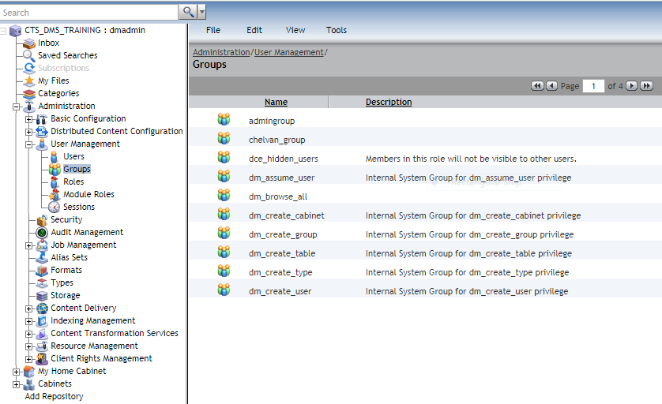
Creating a Group
To create a user in Documentum Administrator or Webtop
Navigate to Administration > User Management > Groups
Select File > New > Group from the menu

Slide 34
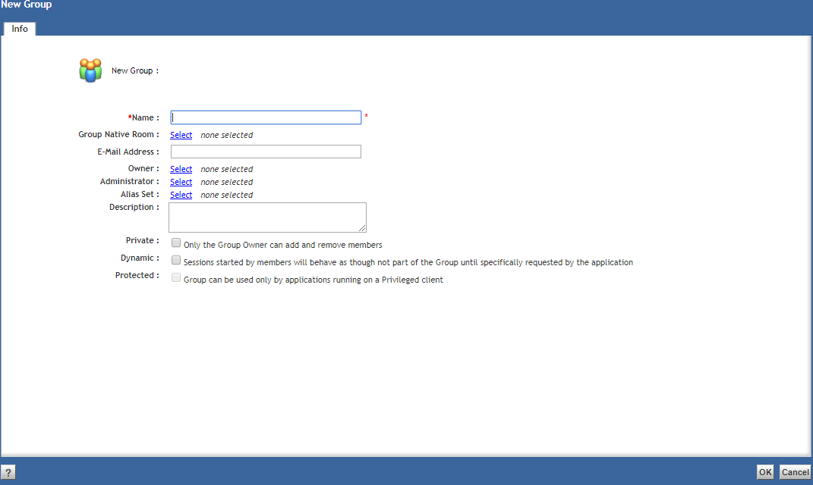
Creating a Group(contd.)
The group Info screen appears
Enter values for the group properties
Click Ok to create the group.

Slide 35
What is Role
A Role is a group with the dm_group.group_class property set to role.
Behaves like a normal group
Roles can enable access to features within applications to a more granular and specific level than what client capability provides.
Roles are specific to client application.
When a role is added to another role, the member role is called a sub-role or derived role . The containing role is called the parent role or the base role.

Slide 36
Role Example
Webtop or Client application can be configured to restrict or enable certain application components based on the user’s role membership.
For Example:
Members of the Group Admins role can access the Administration node.
Members of the Approvers role do not see the Administration node.

Slide 37
Roles can form a hierarchy
Create a role hierarchy by adding roles to roles
The hierarchy below is created by adding the mycontributor role to myconsumer role
Mycontributor inherits from myconsumer
Myconsumer is the base role, mycontributor is derived role
Any user in mycontributor role is a also a myconsumer

Slide 38
Kinds of Group
The kind of groups are identified by attribute dm_group.group_class
Group
Role
Module Role –Its used internally by an installed BOF application.
Privileged Group
A privileged group is a group whose members are allowed to perform privileged operations even though the members do not have those privileges as individuals.
Privileged groups are used in the context of privileged DFC, which is a DFC instance recognized by a Content Server as privileged to invoke higher privileges or permissions for a particular operation.
Domain
The purpose of domain is to identify all roles that apply to an application.
One domain group is created per application. It is specific to client application.

Slide 39
Creating a Role
The requirements for creating a role are identical to those for creating a group.
A role is an instance of the dm_group object
The steps for creating a role are identical to the steps for creating a group,
with the exception of the following property settings:
Create Role as Domain: Select this check box if the role will be used as a domain group.

Slide 40
Useful Queries: Groups and Roles
List all roles in the system:
select group_name from dm_group
Where group_class = ‘role’
List all users who are members of this group, including those who are members of groups contained in this group:
select i_all_users_names from dm_group
where group_name=‘SalesDep’
List all groups a particular user can modify:
Select group_name from dm_group
Where group_admin = ‘Norman’ or
Owner_name =‘Noman’

Slide 41
Test Your Understanding
True/False: You must have SYSADMIN or SUPERUSER privilege to create a group
True
False
Ans: b
Any user with the Create Group privilege can create a
Group. They also need the System Administrator
Client Capability to access the Administration node.

Slide 42
Test Your Understanding
Which attribute of the dm_group object indicates whether or not the group is a role?
group_class
group_source
group_address
Ans: a

Slide 43
Test Your Understanding
True/False: During run time, a client can programmatically add and remove members from a dynamic group?
True
False
Ans: a

Slide 44
Test Your Understanding
Roles are similar to which user setting
Privileges
Client Capability
Permissions
ACL
Ans: b

Slide 45
Exercise
Use Documentum Administrator to:
Create a new group
Create a new role
Add users to your group and role
Issue DQL queries

